Slide 1


Topological Data Analysis on Music Data
Team Members: Siddhant Ranade – u1141131, Yash Gangrade – u1143811
April 29, 2019

Slide 2
Background and Motivation
Music in general is rich in structures. Songs can be viewed as a sequence of notes.
This sequence of notes has repeating patterns, for instance, verses will often have exactly the same tune. Observing carefully, it can be observed that certain phrases (or shorter sequences of notes) occur more frequently than others.

Slide 3
Overview
At a high level:
Define a way to convert a song to a point cloud
Compute persistent homology
Use the persistence barcodes as features for machine learning tasks

Slide 4
Data
MIDI Files -- record musical “events” (i.e. a musical note being played)
Which key?
Pressed or released?
How hard? (“velocity”)
And at what time?
Complete description of the song
Can be played back with a “sound font”
A lot of music is available in this format

Slide 5
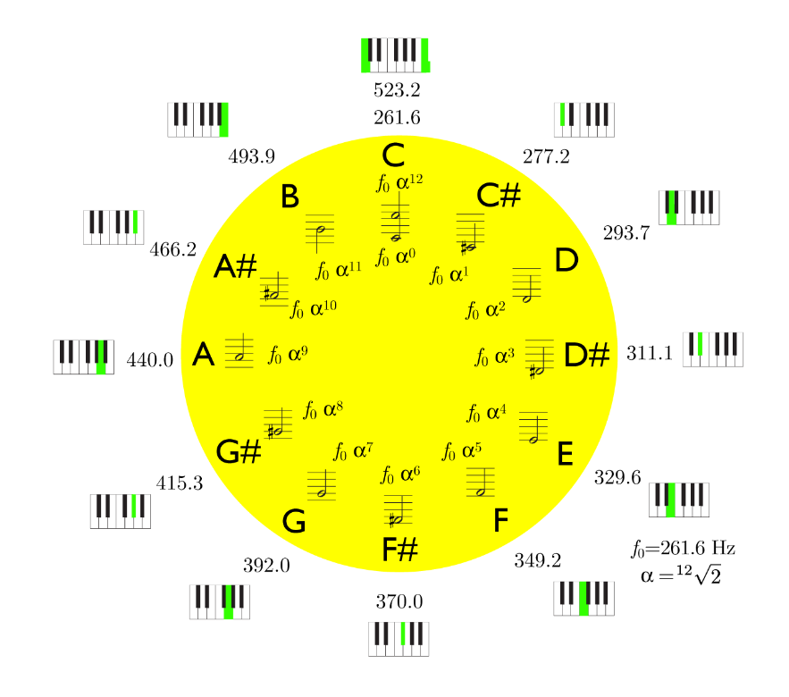
Point clouds (Embedding)
Single note embedding -- 1D point cloud
Notes can be perceived as lying on a circle. Distance between the notes is defined as the distance on this circle.
Distance between C and F is 5, distance between C# and G is 6, and so on.
Does not encode temporal information
Fig. 1: Circle of Notes*
*Source: Sethares et al., Topology of Musical Data

Slide 6
Point clouds (Embedding)
Use a time series embedding:
Consider (overlapping) sequences of consecutive notes with size d
E.g. consider the song with notes E E F G G F E D C C D E E D D
Its length-4 time-series embedding (a 4D pointcloud) would look like:
E E F G
E F G G
F G G F
…
E E D D
Simple way to encode temporal information

Slide 7
Time Series Embedding
The distance between two sequences (i.e. points of the pointcloud) is defined to be the sum of distances between corresponding notes
E.g. the distance between (E, E, F, G) and (E, F, G, G) is 0 + 1 + 2 + 0

Slide 8
TDA+ML Tasks
Compute the persistence barcodes of the pointcloud.
Compute pairwise Wasserstein and Bottleneck distances, embed the point-clouds into 2D using TSNE, and visualize that
Train SVMs to perform tasks such as artist classification and genre classification.

Slide 9
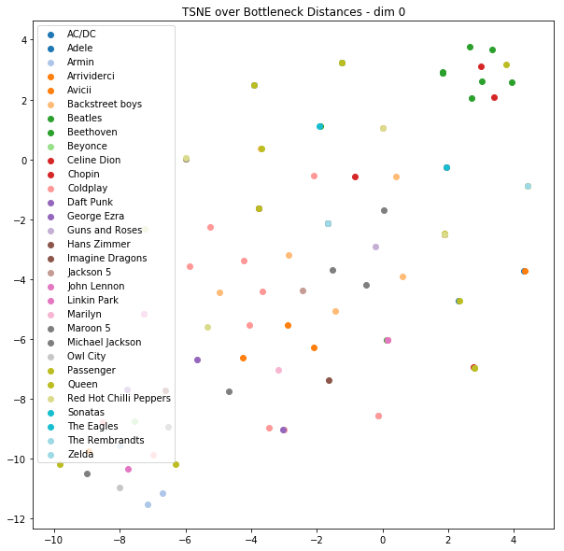
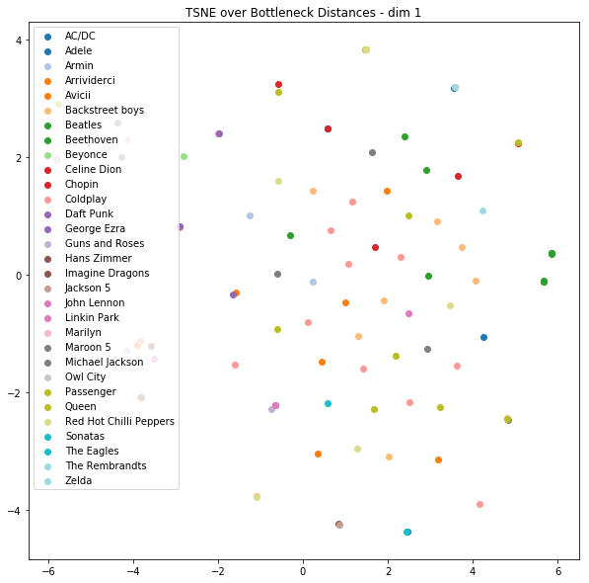
Results - Artist Identification

Slide 10
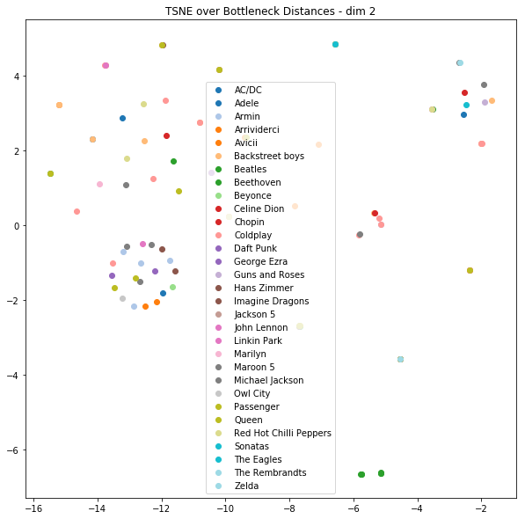
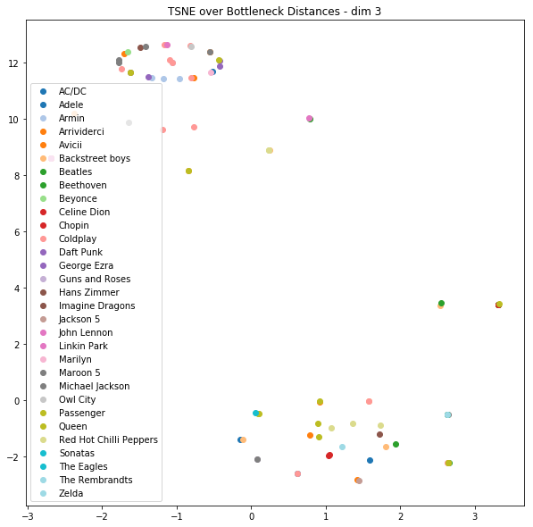
Results - Artist Identification

Slide 11
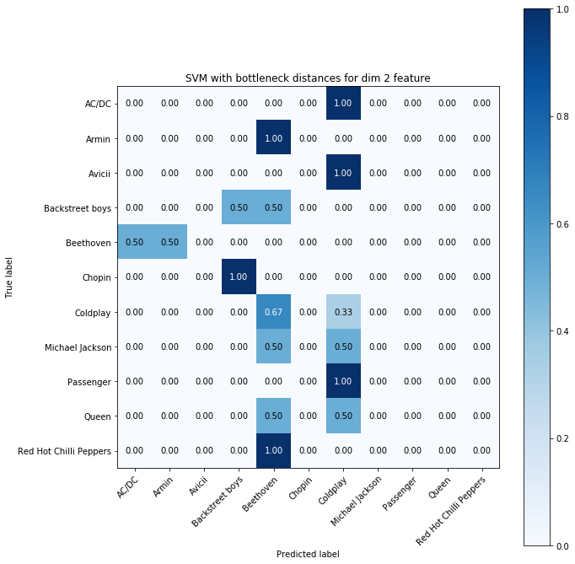
Results - Artist Identification
11 artists in test set
Best accuracy = 17%
Random chance would give us 9%

Slide 12
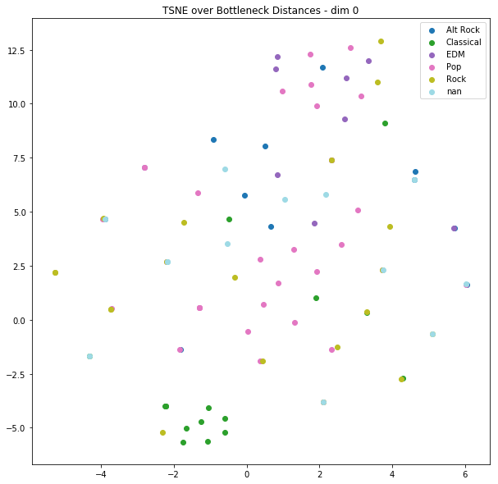
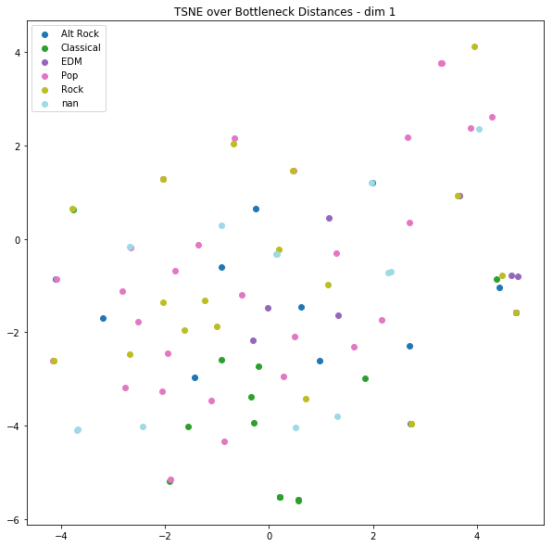
Results - Genre Classification

Slide 13
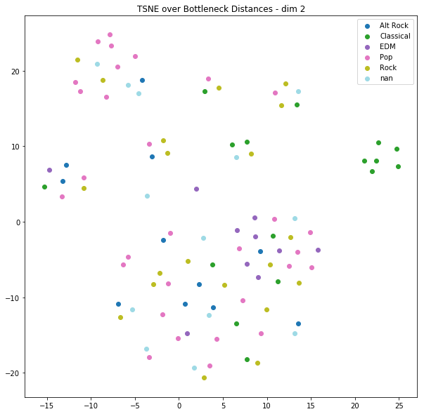
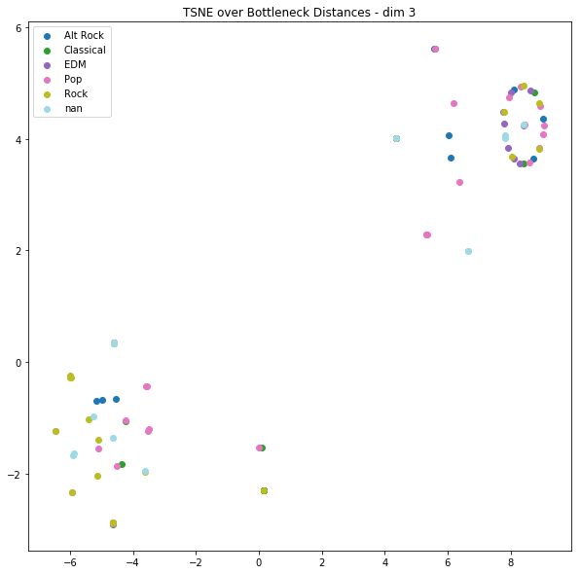
Results - Genre Classification

Slide 14
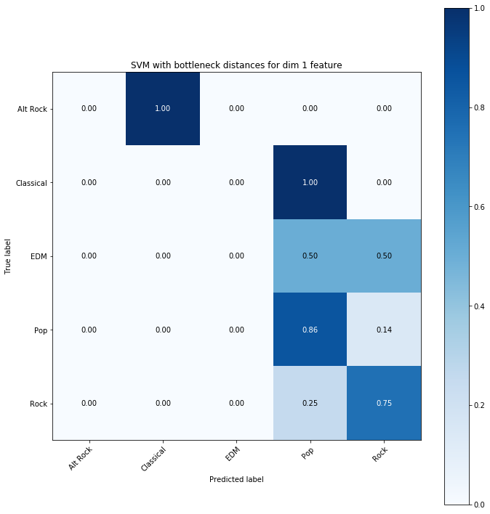
Results - Genre Classification
5 genres in test set
Best accuracy = 52%
Random chance would give us 20%

Slide 15
Conclusion, Future Work
We use topological features to perform ML tasks on musical data.
This works to a certain extent
Collect more data (requires manual work at the moment) -- we have only 100 songs
Use topological features in addition to the music data itself, perhaps with a better model.

Slide 16
“
Thank you!
Questions?
“

